Slide 1
CE 5362 Surface Water Modeling
1D/2D Hydrodynamic Models

Slide 2
St. Venant Equations
Continuity
Lateral inflow
Momentum
Pressure
Gravity drive
Friction Loss
Notes:
If the same inputs (in an algorithm) produce different results, but similar statistical behavior (stochastic)

Slide 3
Computational Cell
Topwidth (B) is a function of depth (and geometry)
Here using z as flow depth variable
Notes:
If the same inputs (in an algorithm) produce different results, but similar statistical behavior (stochastic)

Slide 4
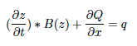
Conservation of Mass
+ρq ΔxΔt
Collapse and simplify (divide by ρΔxΔt)
Notes:
If the same inputs (in an algorithm) produce different results, but similar statistical behavior (stochastic)

Slide 5
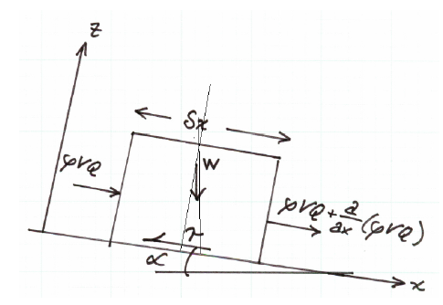
Conservation of Momentum
Change of momentum in the cell is equal to the net momentum entering the cell plus the sum of the forces on liquid in the cell.

Slide 6
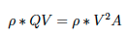
Conservation of Momentum
Momentum entering on the left side of the sketch is

Slide 7
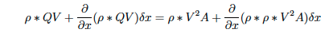
Conservation of Momentum
Momentum leaving on the right side of the sketch is

Slide 8
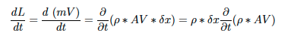
Conservation of Momentum
The momentum accumulating is the rate of change of linear momentum:

Slide 9
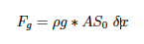
Conservation of Momentum
The gravitational force on the element is the product of the mass in the element and the downslope component of acceleration.

Slide 10
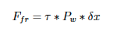
Conservation of Momentum
Friction force is the product of the shear stress and the contact area.
In the reach the contact area is the product of the reach length and average wetted perimeter.

Slide 11
Conservation of Momentum
Friction force is the product of the shear stress and the contact area.
In the reach the contact area is the product of the reach length and average wetted perimeter.
Shear stress model

Slide 12
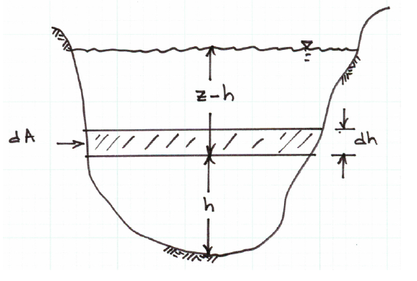
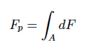
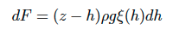
Conservation of Momentum
Pressure force is the product of the integrated pressure and the contact area.
The integral is depth-dependent

Slide 13
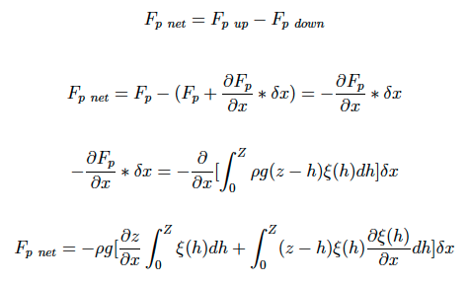
Conservation of Momentum
Net pressure force is up minus down

Slide 14
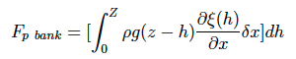
Conservation of Momentum
Bank pressure force

Slide 15
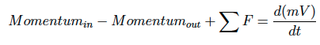
Conservation of Momentum
Collect parts and put into momentum balance

Slide 16
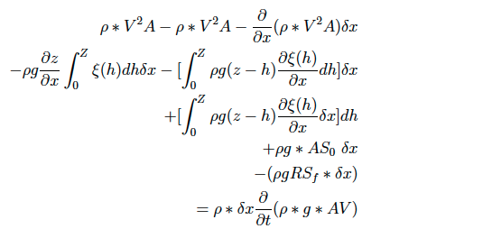
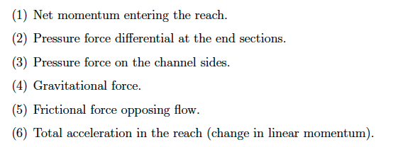
Conservation of Momentum
Collect parts and put into momentum balance

